Slide 1

March 2022
Grants Innovation Exchange Session
Fixed Amount Awards and Other Innovative Award Designs
Office of Management and Budget

Slide 2
Agenda
Introduction
Agency Examples
National Institutes of Health
US Agency for International Development
US Department of State
Q & A
Notes:
So, what is Performance Management?
OMB defines it as: “The use of goals, measurement, evaluation, analysis and data-driven reviews to improve the effectiveness and efficiency of agency operations.”
The Playbook uses a more granular definition that includes program and project results as well as award recipient performance.
So, why does this matter to us right now? Well, we are here today to talk about increasing the focus on results that the American people are receiving from their grant programs.
Lastly, the development of Title 2 of the Code of Federal Regulations emphasizes the importance of sound program design as an essential component of performance management and program administration. A well-designed program has clear goals and objectives that facilitate the delivery of meaningful results. We’ll talk more about this connection next..

Slide 3
Panelists
Michelle Bulls, NIH
Michelle is the Director of the Office of Policy for Extramural Research Administration (OPERA) with policy and compliance oversight for the 24 Institutes and Centers grants management offices within the National Institutes of Health (NIH).
Jonathan Ng, USAID
Jonathan is an Attorney Advisor in the Office of the General counsel at USAID and has covered several portfolios, including Power Africa and the Private Sector Engagement Hub. He most recently served as the Acting Managing Director of USAID’s Innovation Division, which focused on evidence-based grantmaking.
Thomas Kodiak, State
Tom is the Director of Federal Assistance for Financial Management at the State Department.
Notes:
So, what is Performance Management?
OMB defines it as: “The use of goals, measurement, evaluation, analysis and data-driven reviews to improve the effectiveness and efficiency of agency operations.”
The Playbook uses a more granular definition that includes program and project results as well as award recipient performance.
So, why does this matter to us right now? Well, we are here today to talk about increasing the focus on results that the American people are receiving from their grant programs.
Lastly, the development of Title 2 of the Code of Federal Regulations emphasizes the importance of sound program design as an essential component of performance management and program administration. A well-designed program has clear goals and objectives that facilitate the delivery of meaningful results. We’ll talk more about this connection next..

Slide 4
Introduction
Office of Management and Budget

Slide 5
Fixed Amount Award
What is a fixed amount award?
A fixed amount award is a type of grant or cooperative agreement that provides funding without regards to actual costs incurred under the Federal award.
When should a fixed amount award be used?
Appropriate when the work that is to be performed can be determined with a reasonable degree of certainty.
What are the benefits of fixed amount awards?
Reduce some of the administrative burden and record-keeping requirements.
Accountability is based primarily on performance and results.
Notes:
So, what is Performance Management?
OMB defines it as: “The use of goals, measurement, evaluation, analysis and data-driven reviews to improve the effectiveness and efficiency of agency operations.”
The Playbook uses a more granular definition that includes program and project results as well as award recipient performance.
So, why does this matter to us right now? Well, we are here today to talk about increasing the focus on results that the American people are receiving from their grant programs.
Lastly, the development of Title 2 of the Code of Federal Regulations emphasizes the importance of sound program design as an essential component of performance management and program administration. A well-designed program has clear goals and objectives that facilitate the delivery of meaningful results. We’ll talk more about this connection next..

Slide 6
NIH Grant Applications – Modular Budgets
Michelle G. Bulls, Director, Office of Policy for Extramural Research Administration (OPERA)

Slide 7
NIHs Uses Modular Awards as a Version of Fixed Amount Awards
NIH does not issue Fixed Amount Awards.
With prior approval, NIH recipients may issue fixed amount subawards for low-cost activities that fall under the simplified acquisition threshold.
While NIH does not issue fixed amount awards, we use a similar approach to reduce applicant and recipient burden – e.g., modular budgets.
Modular budgets streamline the application process and minimize the need to submit detailed budget information at the time of application submission.

Slide 8
Fixed Amount Subawards

Slide 9
Fixed Amount Subawards
NIH GPS 8.1.2.11: With NIH prior approval, a pass-through entity may provide subawards based on fixed amounts (as defined in 2 CFR Part 200.201 and 45 CFR Part 75.201).
Amounts cannot exceed the Simplified Acquisition Threshold (currently $250,000).
Notes:
Certain conditions apply:
The Fixed amount subaward is negotiated using the cost principles (or other pricing information) as a guide.
The pass-through entity may use fixed amount subawards if the project scope has specific measurable goals and objectives and if adequate cost, historical, or unit pricing data is available to establish a fixed amount subaward based on a reasonable estimate of actual cost.
Payments are based on meeting specific requirements of the subaward. Accountability is based on performance and results.

Slide 10
Modular budgets

Slide 11
NIH Use of Modular Budgets
Implemented in 1999, after an extensive 4-year pilot.
Applies to research grant applications from domestic organizations proposing $250,000 or less per budget period in direct costs
Excludes foreign organizations, SBIR/STTR awards and applications proposing the use of Human Fetal Tissue. Exceptions may also be outlined in Funding Opportunity Announcements
Notes:
Pilot tested over four years in more than 25 separate solicitations, covering a wide variety of award mechanisms issued by the National Heart, Lung and Blood Institute (NHLBI) and the National Institute of Allergy and Infectious Disease (NIAID).
At the time of implementation, NIH data indicated that almost 90 percent of competing individual research project grant (R01) applications request $250,000 or less in direct costs. On the basis of this experience, the size of the modules and the maximum of $250,000 were selected.
https://grants.nih.gov/grants/guide/notice-files/not98-178.html

Slide 12
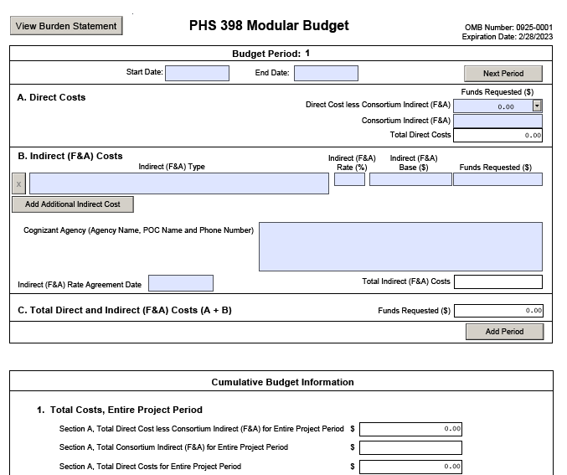
Modular Budget Requirements
Request total direct costs in modules of $25,000.
Generally, modular grant applications will request the same number of modules in each year.
Include a total cost estimate for any Consortium/Contractual arrangements (within the modules).
Budget justification for personnel and consortiums
Significant rebudgeting considerations do not apply - changes in scope still require prior approval
Learn more: NIH Office of Extramural Research – Develop Your Budget

Slide 13
Peer Review of Modular Budgets How Does it Work?
Standard peer review criteria apply as outlined in the Notice of Funding Opportunities (NOFO). Unless specified otherwise in the NOFO, consideration of the budget and project period should not affect the overall impact score.
Peer reviewers consider the entire proposed research project and the total direct costs needed to complete the project in the recommended period.
The Scientific Review Group (SRG) makes a committee recommendation on the budget request and project period requested.
The SRG may recommend the elimination or addition of one or more $25,000 modules or specific budget items

Slide 14
Post-Award Management
Significant rebudgeting (e.g. changes in a cost category of more than 25 percent of the total costs awarded) does not apply to awards with a modular budget
Still required to obtain prior approval for any changes in scope
Recipients must ensure that all costs charged to modular awards are in accordance with cost principles (NIH GPS 13.5)
Administrative supplement requests require a detailed budget
Competitive revision applications use the modular budget format

Slide 15
Use of Modular Budgets
Approximately 29 % of NIH grant applications in FY21 used a modular budget.
Down from approximately 47% of electronic applications submitted in 2007.
FY20 Average Grants size for R01 equivalent awards: $560,000 (FY21 data not yet available).
Notes:
2007 is the first year with data on modular budgets submitted electronically

Slide 16
FIXED AMOUNT AWARDS
OMB Grants Innovation Exchange – Fixed Amount Awards and Other Innovative Award Designs
March 17, 2022

Slide 17
USAID Fixed Amount Awards (FY 2017-21)
 | FY 17 | FY 18 | FY 19 | FY 20 | FY 21 | 5-Yr. Avg.
# New Fixed Amount Awards | 143 | 117 | 88 | 117 | 137 | 120.4
Total Amount | $146M | $53M | $58M | $102M | $97M | $91.2M (~$757k/award)

Slide 18
Fixed Amount Awards in Practice
1.) Can promote innovation + evidence across the US government:
Importance of working within the existing system (FAAs are an existing instrument)
Readily facilitates Pay-for-Results approaches with milestone-based payments
Puts into practice the “Performance over Compliance” principle
2.) Common design/management issues and critiques
3.) USAID examples: Cambodia; Development Innovation Ventures
Resources: See USAID’s ADS 303saj (revised Jan. 2022)

Slide 19
US Department of State
Example of Fixed Amount Awards
Office of Management and Budget

Slide 20


U.S. Department of State
Fixed Amounts Awards: Costs are negotiated and agreed upon up front. As long as the objectives are met, the recipient is entitled to the full grant amount–and no more or less.
Department of State Requirements:
Award must be $250,000 or less.
Clearly identifiable goals and objectives based on performance and results.
Monitoring plan shows how those milestones will be documented (e.g. recipient reporting, phone calls/emails to recipient, attendance at events).
Costs are predictable and can be determined in advance, and will not fluctuate much once the award starts.
Period of performance must be less than five years, though FAAs are typically much shorter.
At the end of the period of performance the recipient must certify in writing that all milestones have been completed successfully.
Cannot be used where program income is earned.
All pre-award requirements still apply: risk assessment, SAM.gov registration, budget negotiation.

Slide 21
Questions?
Office of Management and Budget

